Slide 1

6th Grade Accelerated Math
Unit 12, Lesson 7 Percent Increase and Decrease Volume 2, pg. 247

Slide 2


Benchmark
MA.7.AR.3.1
Apply previous understanding of percentages and ratios to solve multi-step, real-world percent problems.
volume 2, pg. 247

Slide 3
Integrated Mathematical Thinking and Reasoning Standards
MA.K12.MTR.2.1 Demonstrate understanding by representing problems in multiple ways.
MA.K12.MTR.4.1 Engage in discussions that reflect on the mathematical thinking of self and others.
MA.K12.MTR.7.1 Apply mathematics to real-world contexts.
volume 2, pg. 247

Slide 4

Learning Target
I can find percent increase or percent decrease.
volume 2, pg. 247

Slide 5

Warm-Up
volume 2, pg. 247

Slide 6
12.7.1 Warm-Up: Interpreting Percentages
If exactly 93.6% of people completed a survey, what is the fewest number of people that were surveyed? Consider: How could it be determined if only one person could have completed it? Can partial people complete the survey?
Explain your answer using mathematics.
volume 2, pg. 247

Slide 7

Guided Instruction
volume 2, pg. 248

Slide 8
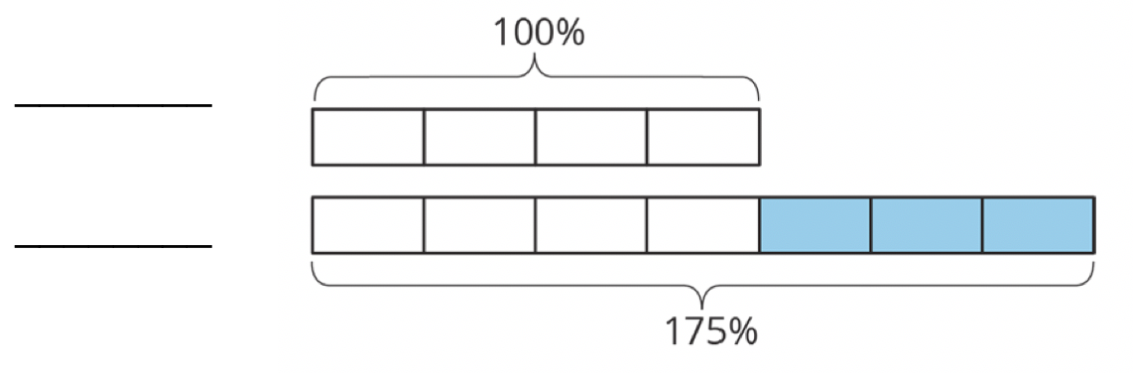
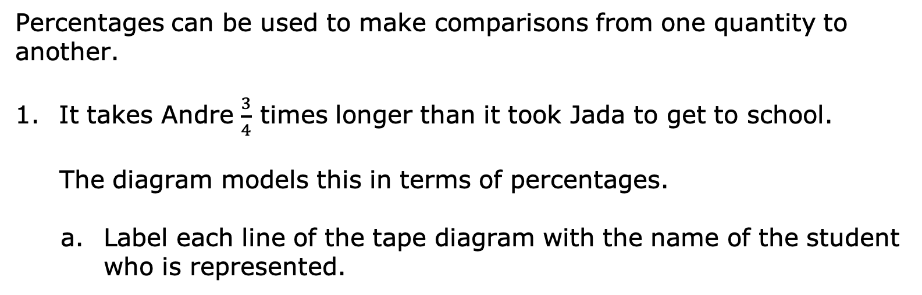
12.7.2 Guided Instruction: Percent of Change
Percentages can be used to make comparisons from one quantity to another.
It takes Andre $\frac{3}{4}$ times longer than it took Jada to get to school.
The diagram models this in terms of percentages.
Label each line of the tape diagram with the name of the student who is represented.
volume 2, pg. 248

Slide 9
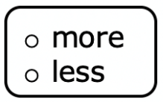
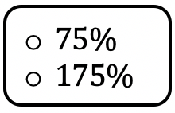
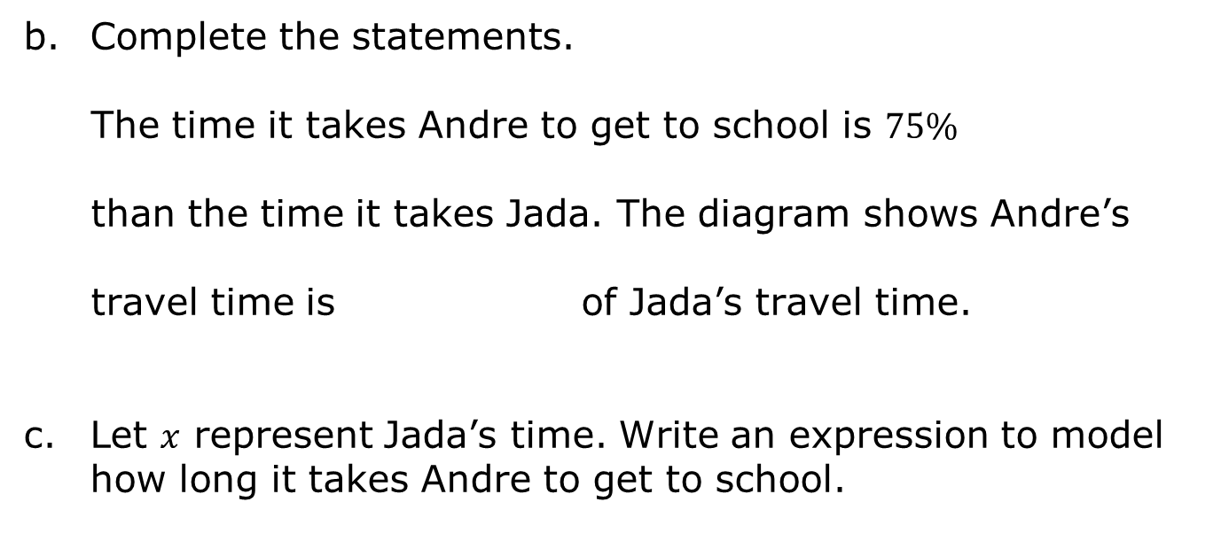
Complete the statements.
The time it takes Andre to get to school is $75\%$
than the time it takes Jada. The diagram shows Andre’s
travel time is of Jada’s travel time.
Let $x$ represent Jada’s time. Write an expression to model how long it takes Andre to get to school.
volume 2, pg. 248

Slide 10

If it takes Jada 8 minutes to get to school, calculate how long it takes Andre to get to school.
The terms “percent increase” and “percent decrease” are used to describe a specific percent of change.
A double number line can also be used to model percent increase or percent decrease.
A percent of change is the difference between a final value and an initial value, expressed as a percentage of the initial value.
volume 2, pg. 248

Slide 11
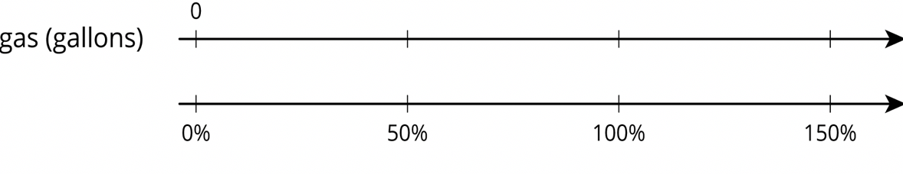
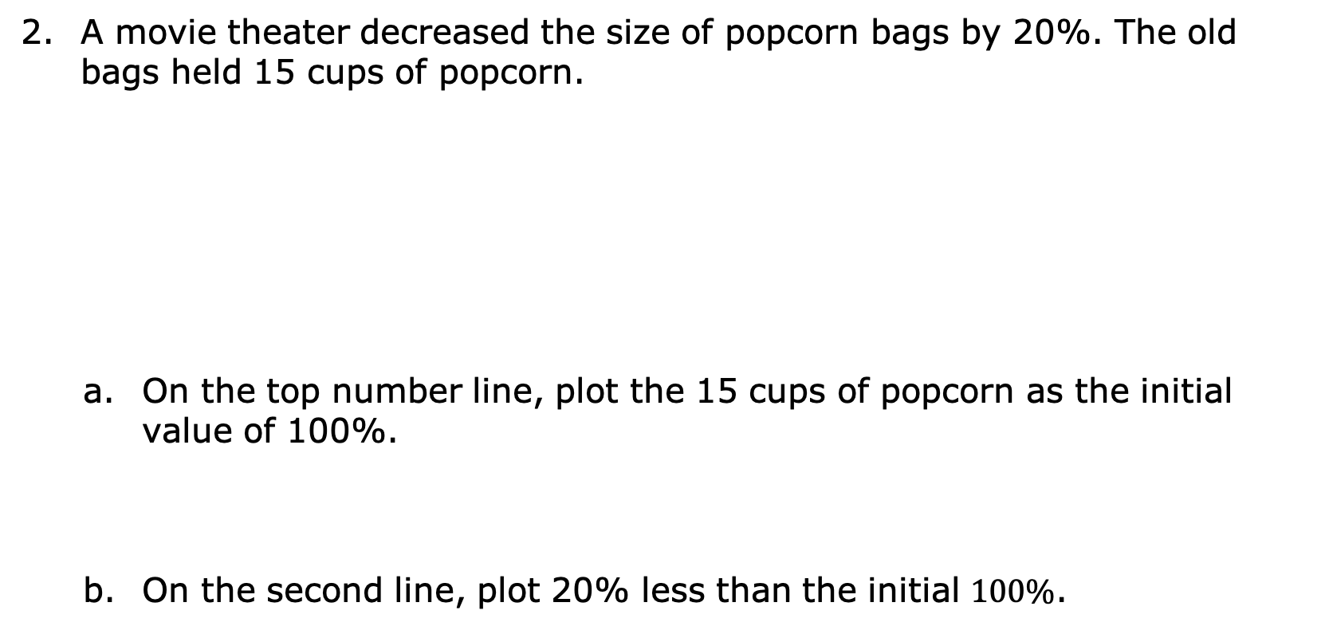
A movie theater decreased the size of popcorn bags by 20%. The old bags held 15 cups of popcorn.
On the top number line, plot the 15 cups of popcorn as the initial value of 100%.
On the second line, plot 20% less than the initial $100\%$.
volume 2, pg. 248

Slide 12

Use the double number line to find the number of cups in the smaller bag.
Discuss with your partner how the double number line is helpful for determining the impact of a $20\%$ decrease in the size of the popcorn bag.
volume 2, pg. 249

Slide 13

Try It
volume 2, pg. 249

Slide 14

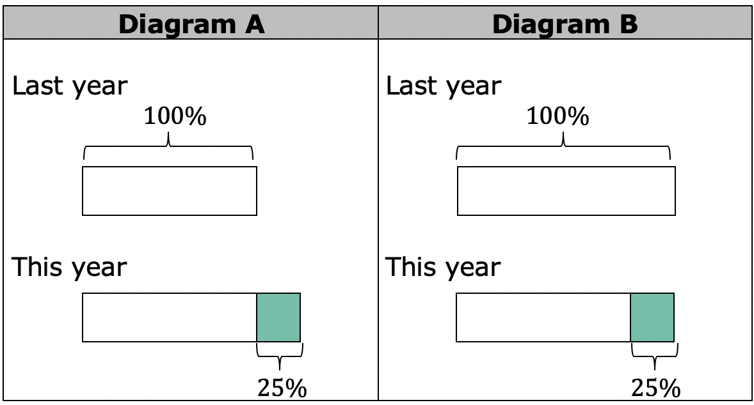
12.7.3 Try It: Percent of Change
Explain which diagram, A or B, matches each situation.
volume 2, pg. 249

Slide 15
Situation | Matching Diagram | Reason
Compared to last year’s strawberry harvest, this year’s increased 25%.
This year’s blueberry harvest is 75% of last year’s.
Compared to last year, this year’s peach harvest decreased by 25%.
This year’s plum harvest is 125% of last year’s plum harvest.
volume 2, pg. 249

Slide 16
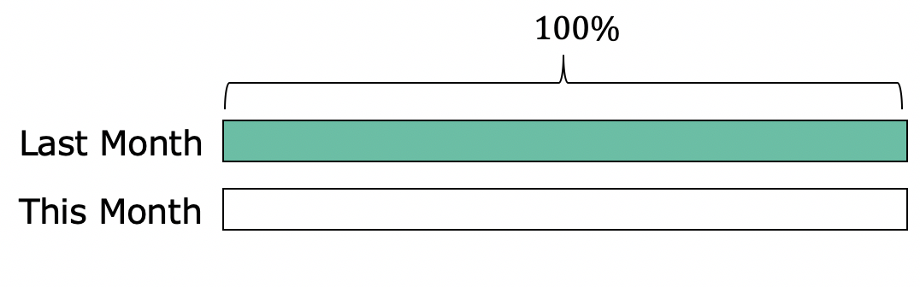
The number of mosquitoes decreased by 80% from last month to this month. Create a tape diagram of this month to represent the situation.
volume 2, pg. 250

Slide 17
The gas tank in Robert’s truck holds 12 gallons. The gas tank in his mom’s truck holds 50% more gas. Using the double number lines, determine how many gallons the gas tank of Robert’s mom’s truck holds.
volume 2, pg. 250

Slide 18

Collaboration
volume 2, pg. 250

Slide 19

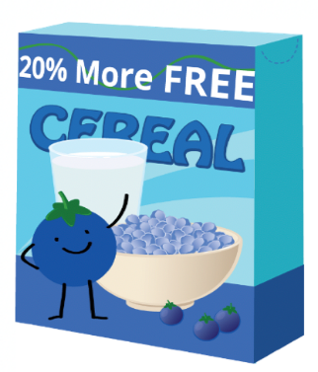
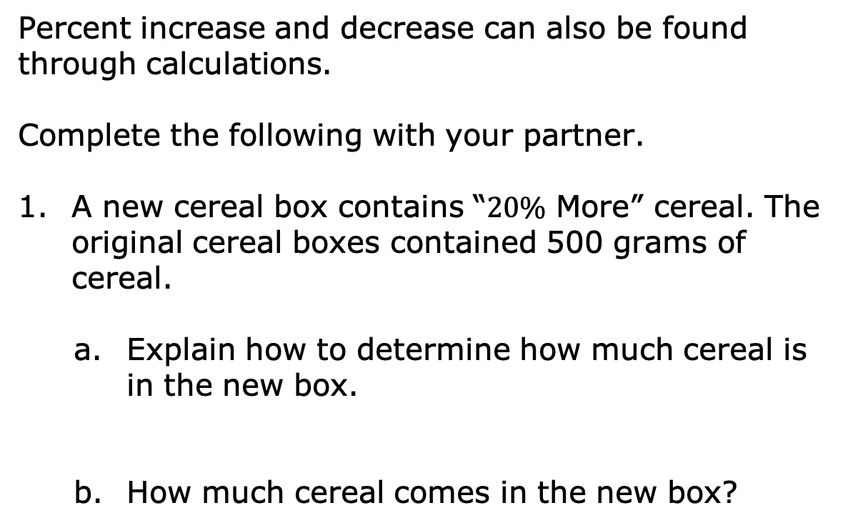
12.7.4 Collaboration: Calculating Percent Increase or Decrease
Percent increase and decrease can also be found through calculations.
Complete the following with your partner.
A new cereal box contains “$20\%$ More” cereal. The original cereal boxes contained 500 grams of cereal.
Explain how to determine how much cereal is in the new box.
How much cereal comes in the new box?
volume 2, pg. 250

Slide 20

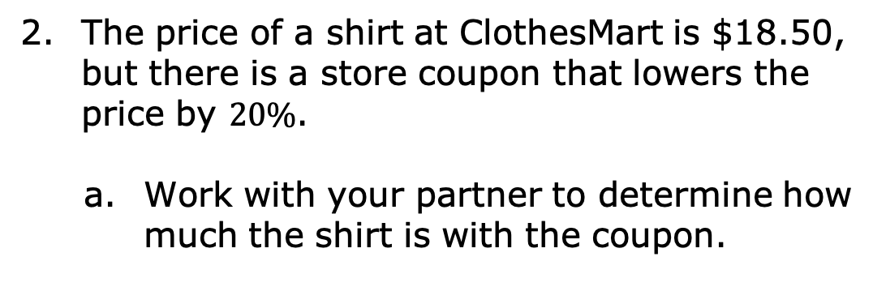
The price of a shirt at ClothesMart is $18.50, but there is a store coupon that lowers the price by $20\%$.
Work with your partner to determine how much the shirt is with the coupon.
volume 2, pg. 251

Slide 21
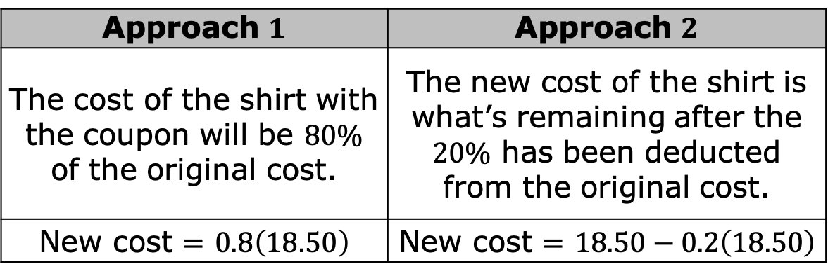
The table shows two different ways to complete this problem, along with corresponding answers.
Explain whether or not these equations are equivalent.
Approach $1$ | Approach $2$
The cost of the shirt with the coupon will be $80\%$ of the original cost. | The new cost of the shirt is what’s remaining after the $20\%$ has been deducted from the original cost.
New cost $=$ $0.8\left(18.50\right)$ | New cost $=$ $18.50−0.2\left(18.50\right)$
volume 2, pg. 251

Slide 22


Did your answer to Part A match the solution(s) of the equations in the table?
Percent of Change $=100 × \frac{Final Value−Initial Value}{Initial Value}$
volume 2, pg. 251

Slide 23
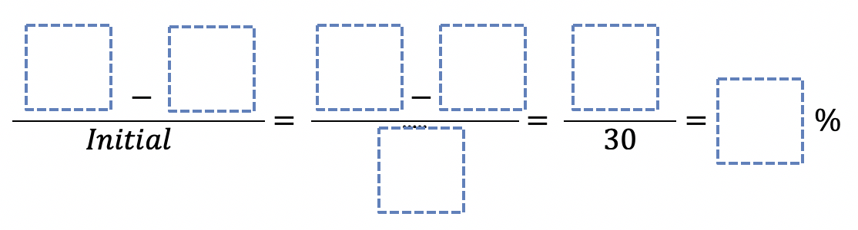
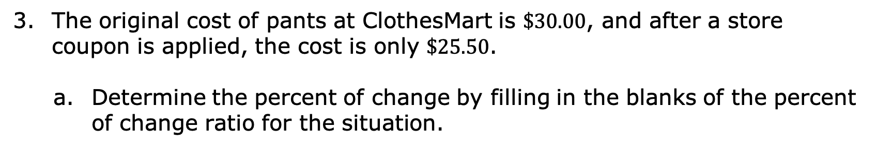
The original cost of pants at ClothesMart is $\$30.00$, and after a store coupon is applied, the cost is only $\$25.50$.
Determine the percent of change by filling in the blanks of the percent of change ratio for the situation.
Explain whether the percent of change represents a percent increase or decrease based on its value.
volume 2, pg. 252

Slide 24
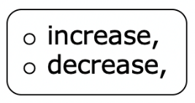
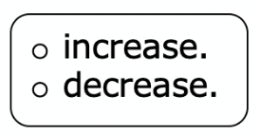
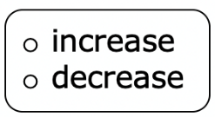
Complete the statements.
When calculating the percent of change using the ratio,
a positive value represents a percent
and a negative value represents a percent
In this context, it makes sense that the percent change is a
percent because the change is the result of a
discount.
volume 2, pg. 252

Slide 25

Your Turn
volume 2, pg. 252

Slide 26
12.7.5 Your Turn!
A school had 1,200 students last year and only 1,080 students this year. What was the percentage decrease in the number of students?
A juice box has 20% more juice in its new packaging. The original packaging held 12 fluid ounces. How much juice does the new packaging hold?
volume 2, pg. 252

Slide 27

Wrap-Up
volume 2, pg. 253

Slide 28
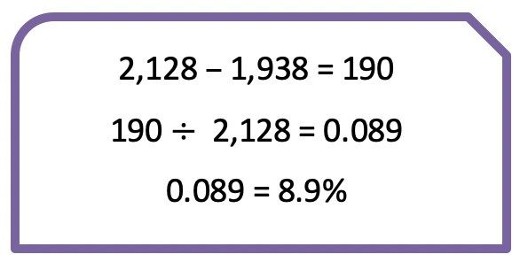

12.7.6 Wrap-Up: Error Analysis
The number of campers who attend a local summer camp has increased from $1,938$ to $2,128$. The camp director calculates the percent of increase for an upcoming presentation. Her work is shown.
Explain the camp director’s mistake.
volume 2, pg. 253

